Slide 1
MATLAB Programming 2022 Spring
Final Exam One
Instructor: 黃世強 (Sai-Keung Wong)

Slide 2
Content
There are two problems. You must answer all of them.
Write a program to solve each problem. The program must be interactive. You can press keys to generate key events for your program to handle.
You can create new files for functions.
If there are templates, you can use them.

Slide 3
About demo video and demo programs.
A demo video or a demo program may have bugs. They show or illustrate roughly the results. These results may not be exactly the same as the requirements stated in the instruction. They are for your own reference and you do not need to refer to them.
You must follow the instruction to finish your programs.

Slide 4
About template programs in the package
If there are template program(s) in the package, you can use them.
You do not need to use the template program(s).
You are encouraged to write extra functions in new files.
Make sure that you MUST store all the files in the same folder.

Slide 5
Program file name format
Write all your programs in a folder. The folder name is mat_exam_01_student_ID. For example, if your ID is 12345678, the folder name is mat_exam_01_12345678.
Zip the folder and upload it.
Write a program for each problem in one file.
The file name is ex01_X_yourStudentID.m, where X is the problem number.
For example, if your student ID is 12345678 and the problem number is 3, then the file name must be ex01_3_12345678.m.
You must not output all the intermediate results.
Output the results that are required only.

Slide 6
File content header
At the top of the file, write down your name, ID, email address, department, and date. If you do not do so, you receive a score of zero in the corresponding problem.
%%%%%%%%%%%%%%%%%%%%%%%%%%%
% Final Exam Number: …
% Problem number: …
% Student Name: …
% Student ID: …
% Email address: …
% Department:
% Date: ….
%%%%%%%%%%%%%%%%%%%%%%%%%%%%

Slide 7
File content
For each problem, display the problem number before showing the results.
close all; clear; clc; % close all windows
% clear variables, and clear screen
disp(‘Final Exam Problem 1.1') % show Final Exam Problem 1.1

Slide 8
(40%) Problem 1.1. A simple interactive application
Plot y(x) = [ sin(x) * z1(x) * sin(z2(x)+0.05) ] / z2(x)
z1(x) = e^{- w * cos (x/4)} + u * (1+w*w) * cos(x)
z2(x) =(x – w) * (x-w*w) * (cos(x/4)*sin(x/4)+1)
The curve of y is divided into two or three segments due to one or two singular points. When w = w*w (i.e., w = 0 or w = 1), there is only one singular point.
Must use a callback function to handle the key events.
Initially u = 0.1 and w = -2.
Display the segments in different colors (e.g., red, green, black).
The line width of the segments is 3. The segments must be smooth.
The interval of x is [-6, 6]. Must use step size dx = 0.001.
Use axis([-6 6 -6 6]) to set the axis limits.
Set font size must be 20. set(gca,'FontSize',20);

Slide 9
(40%) Problem 1.1.
y(x) = [ sin(x) * z1(x) * sin(z2(x)+0.05) ] / z2(x)
z1(x) = e^{- w * cos (x/4)} + u * (1+w*w) * cos(x)
z2(x) =(x – w) * (x-w*w) * (cos(x/4)*sin(x/4)+1)
When w = w*w (i.e., w = 0 or w = 1)
there is only one singular point.
w
0
w²
Case 1
x
Let s be a small value, e.g., s = 0.00001.
Thus, several cases should be considered.
Case 1: w < 0. Two singular points. 3 segments.
Case 2: w = 0. One singular point. 2 segments.
Case 3: w > 0. There are three sub-cases.
(Case 3:A) When 0 < w < 1, w*w < w.
3 segments.
Example:
x = [-6:dx:w*w-s], x = [w*w+s:dx:w-s], x = [w+s:dx:6].
(Case 3:B) When w = 1, one singular point. 2 segments.
(Case 3:C) When w > 1, two singular points. 3 segments.
0
Case 2
x
w
0
1
w
Case 3:A
x
w²
0
1
Case 3:B
x
w
0
1
w
w²
Case 3:C
x

Slide 10
(40%) Problem 1.1. A simple interactive application
Plot the segments on the same window.
The interval for u must be [0, 3].
Press ‘j’ to decrease u by 0.125. Clear the figure. Plot curve y vs x.
Press ‘k’ to increase u by 0.125. Clear the figure. Plot curve y vs x.
The interval for w must be [-2, 2].
Press ‘n’ to decrease w by 0.125. Clear the figure. Plot curve y vs x.
Press ‘m’ to increase w by 0.125. Clear the figure. Plot curve y vs x.
A callback function is used to handle the key events.
Show u and w as the title of the figure. Display each of them with at least 4 digits and decimal places.
Press ‘q’ to show the student ID on the console window, close figure window(s), and then quit the program.

Slide 11
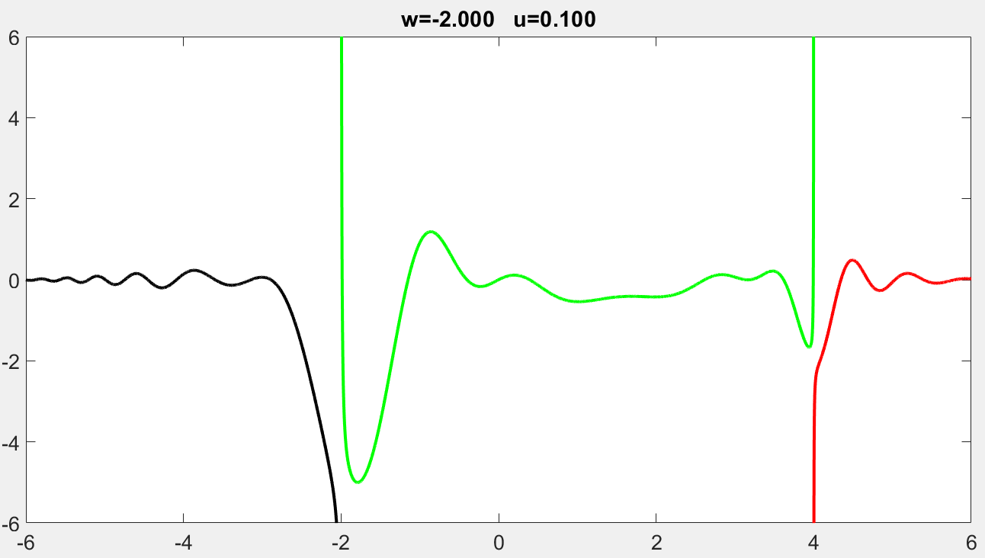

Slide 12
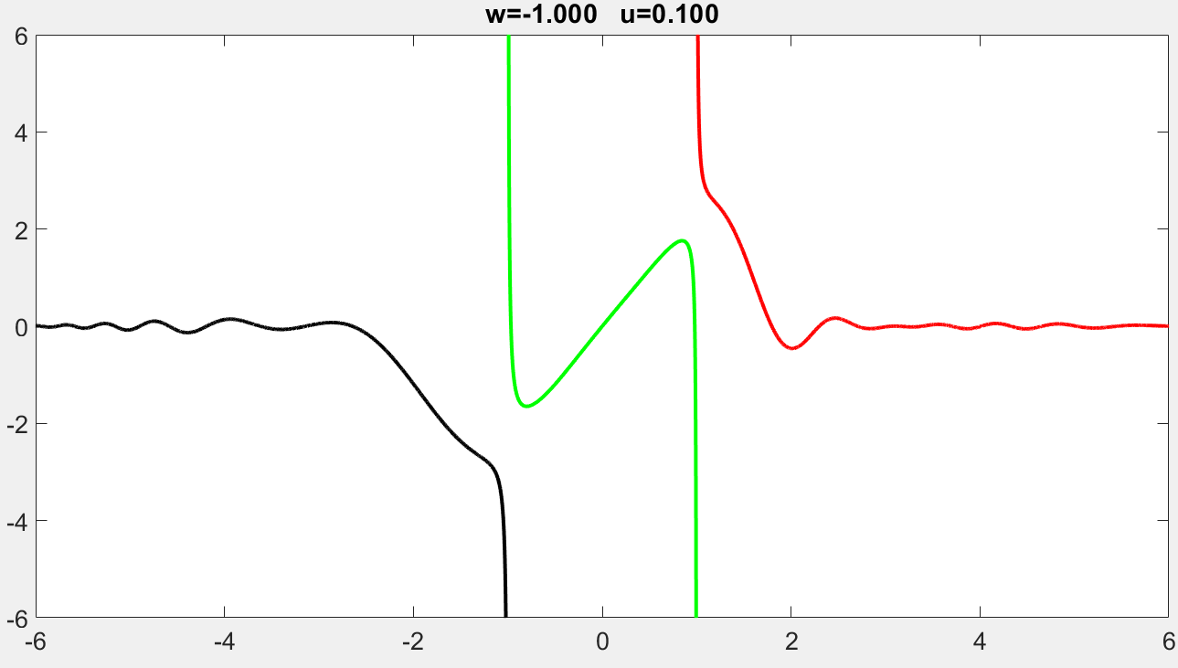
Play to see the demo.

Slide 13
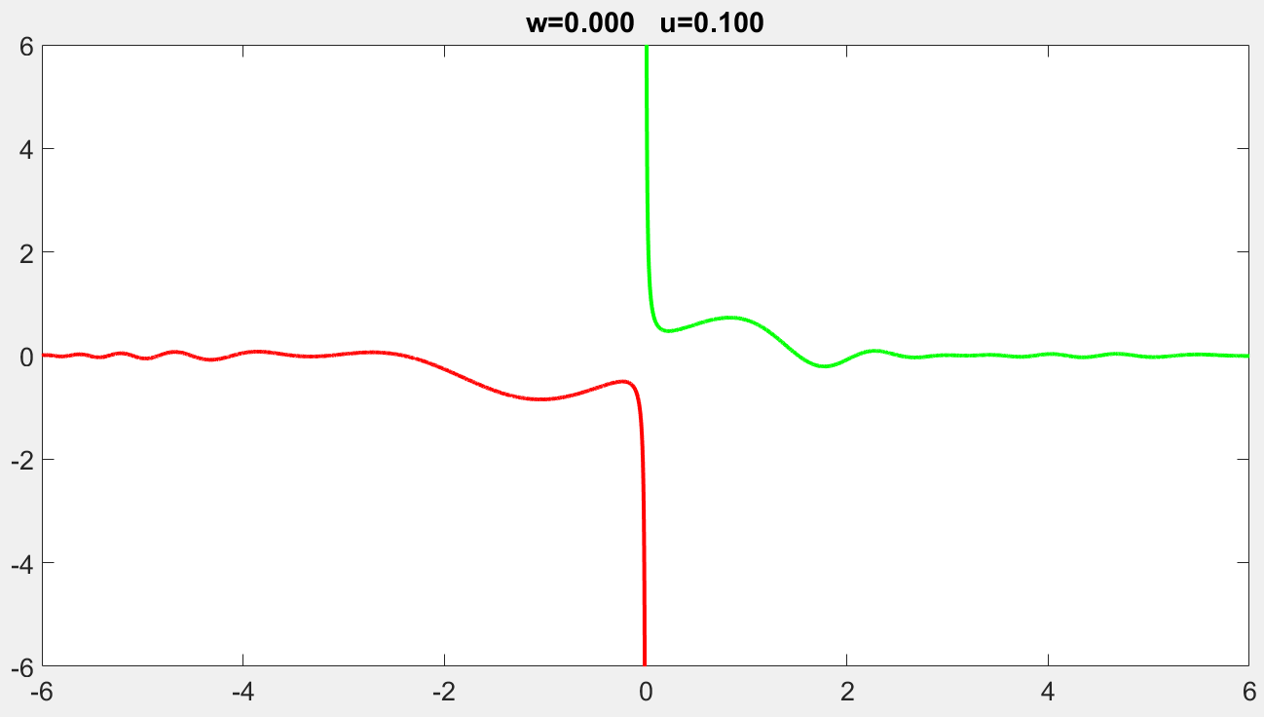
Play to see the demo.

Slide 14
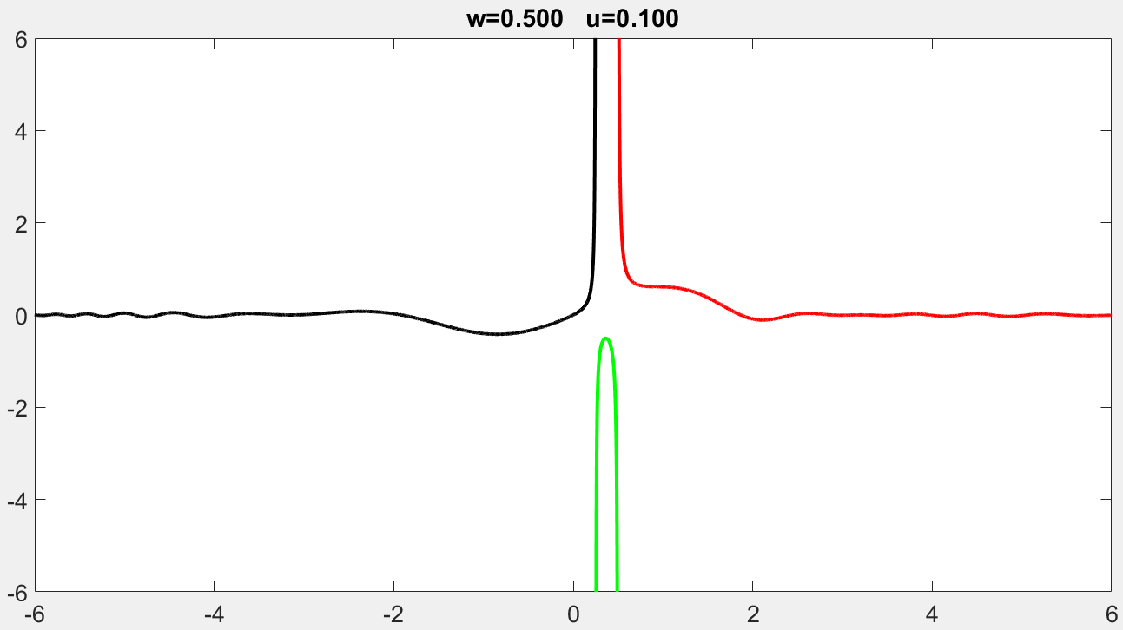
Play to see the demo.

Slide 15
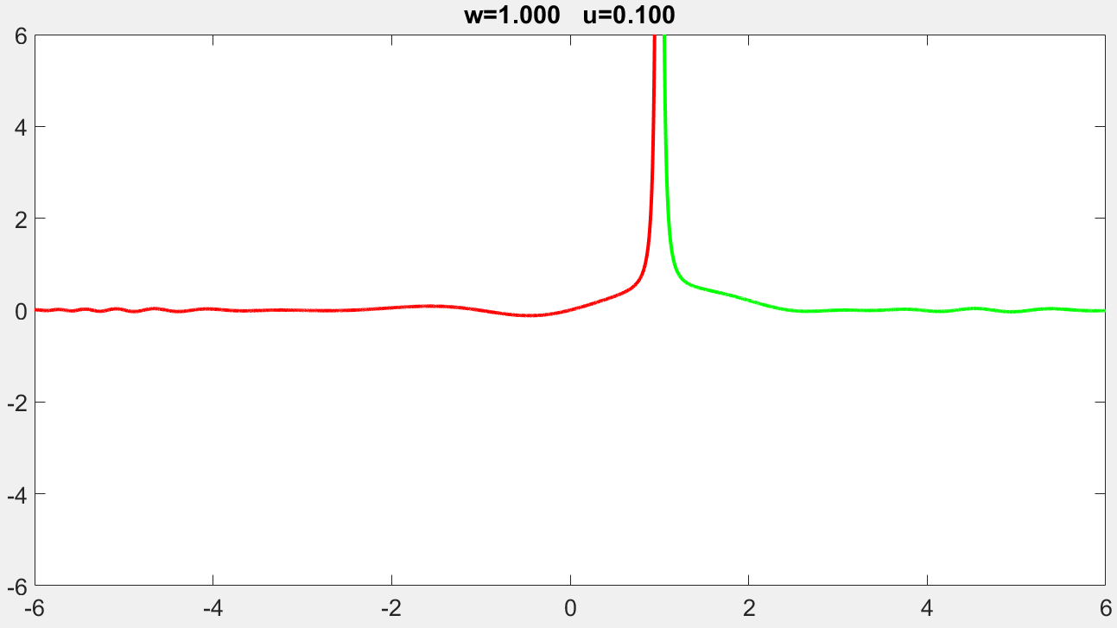

Slide 16
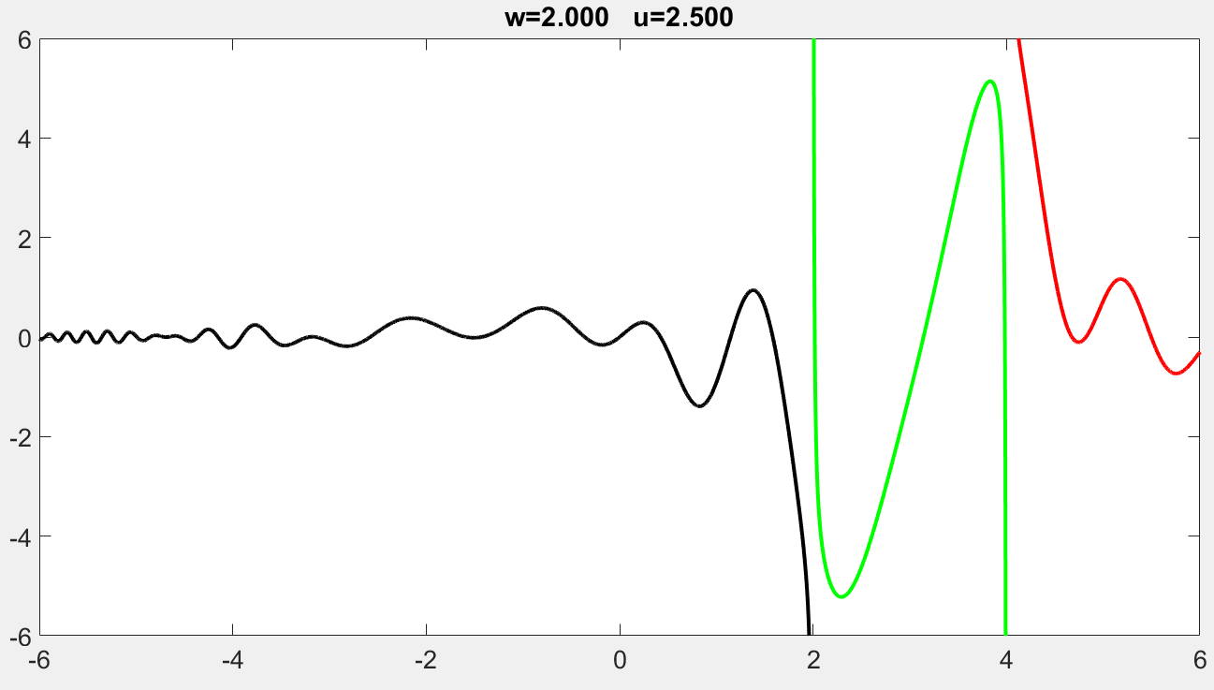

Slide 17
(40%) Problem 1.1. Marking Scheme
[1%] Press ‘q’ to show the student ID and name on the console window, close figure window(s), and then quit the program. Deduct 20% if this item is not implemented.
[4%] A callback function is used to handle all the key events.
[2%] Press ‘j’ to decrease u by 0.125.
[2%] Press ‘k’ to increase u by 0.125. The segments are correct.
[2%] The interval of u is [0, 3].
[3%] Press ‘n’ to decrease w by 0.125. The segments are correct.
[3%] Press ‘m’ to increase w by 0.125. The segments are correct.
[4%] There must be two segments when w = 0 and w = 1.
[3%] When 0 < w < 1, the segments are correct.
[2%] The interval of w is [-2, 2].
[10%] The segments are drawn in different colors. They are correct.
[3%] Show u and w as the title of the figure. They have at least 4 digits and decimal places.
[1%] set(gca,'FontSize',20);
y(x) = [ sin(x) * z1(x) * sin(z2(x)+0.05) ] / z2(x)
z1(x) = e^{- w * cos (x/4)} + u * (1+w*w) * cos(x)
z2(x) =(x – w) * (x-w*w) * (cos(x/4)*sin(x/4)+1)
When w = w*w (i.e., w = 0 or w = 1)
there is only one singular point.

Slide 18
Problem 1.2
This page is empty. Please turn to the next page.

Slide 19
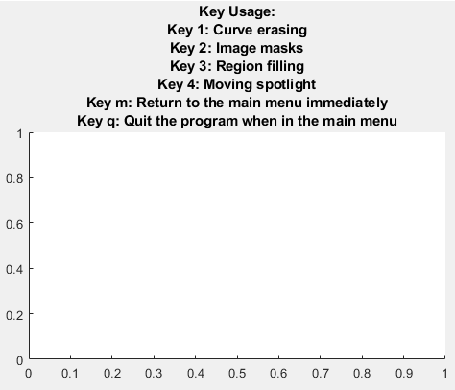
(60%) Problem 1.2. An interactive system
The following shows the options of the program.
Use a callback function to handle the key events.
Show the main menu
'1': Curve erasing
'2': Image masks
'3': Region filling and clearing
'4': Moving spotlight
'm': Return to the main menu immediately
's': stop the animation (if any)
'q': Quit the program when in the main menu
Press a key to perform the corresponding option.

Slide 20
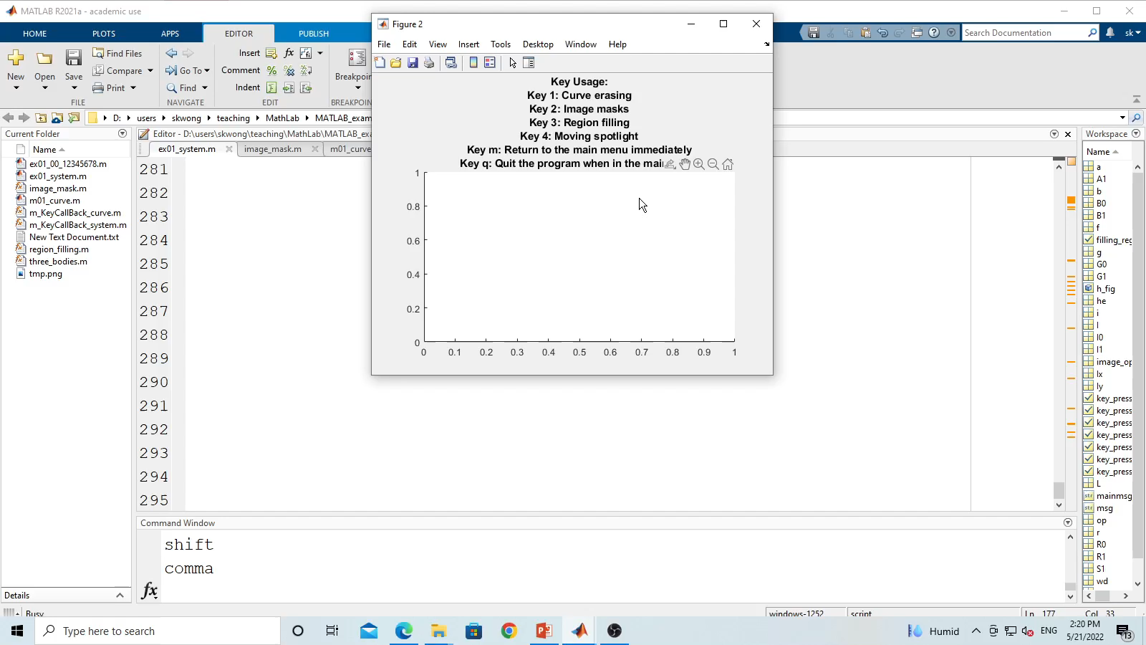
Demo
Option 1. Curve Erasing
Notice that ‘s’ can be pressed to stop the animation at any time.
After that press ‘m’ to return to the main menu.

Slide 21
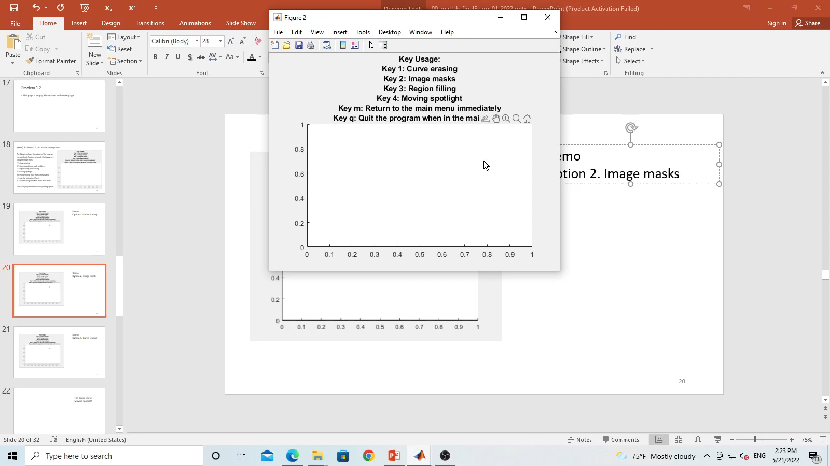
Demo
Option 2. Image masks
Notice that the mask is switched between horizontal pattern to vertical pattern.
After that press ‘m’ to return to the main menu.

Slide 22
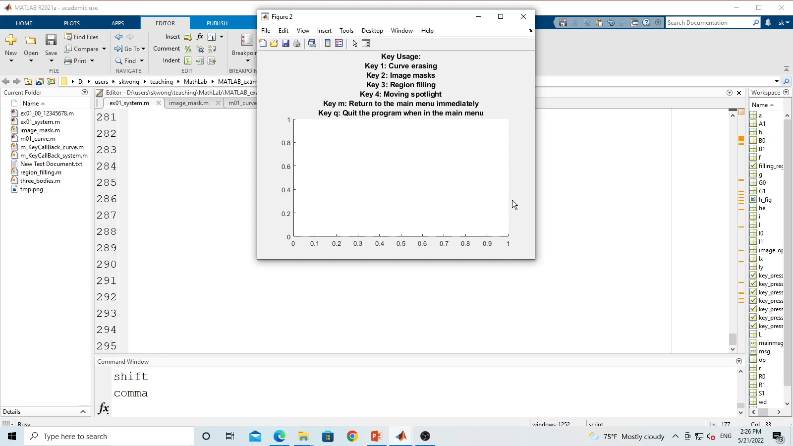
Demo
Option 3. Region filling and clearing
The region is filled and cleared.
Notice that ‘s’ can be pressed to stop the animation at any time.
After that press ‘m’ to return to the main menu.

Slide 23
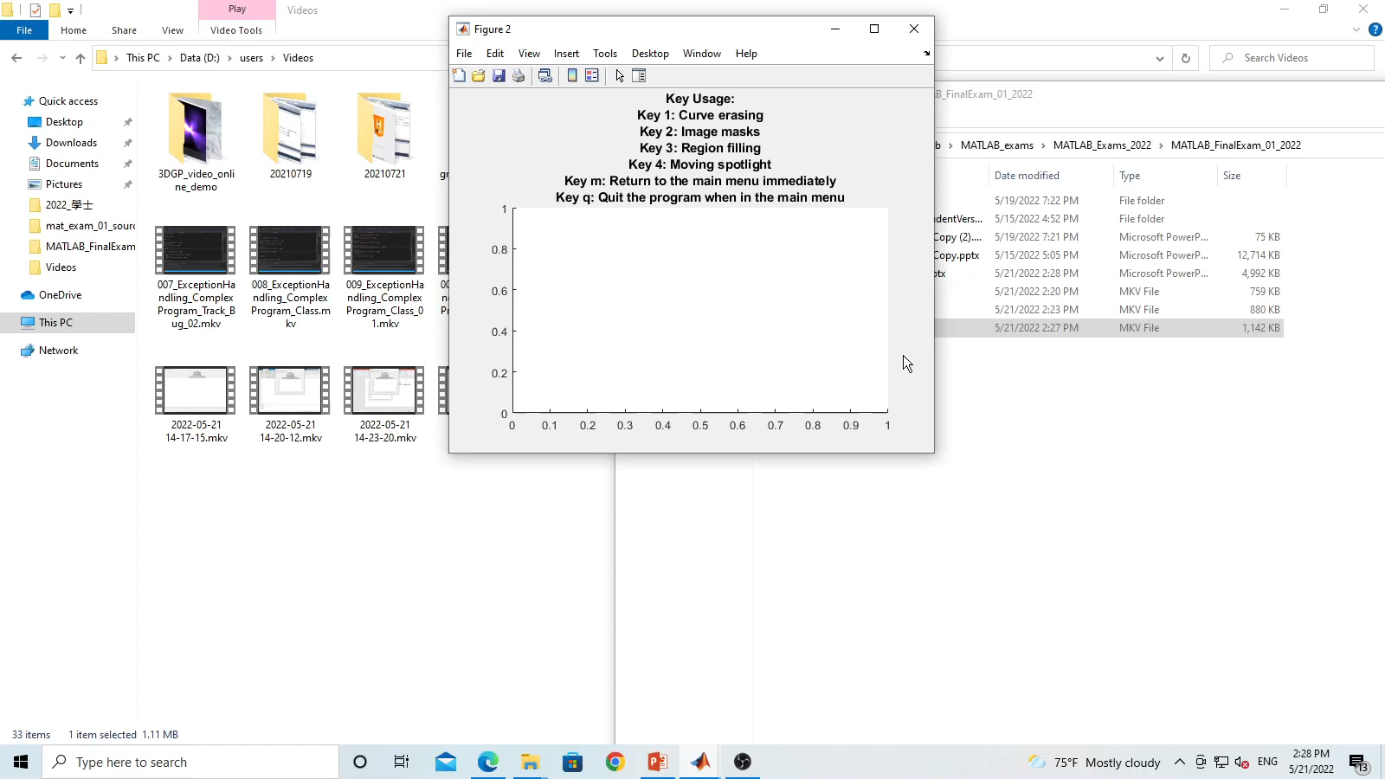
Demo
Option 4. Moving spotlight
Notice that ‘s’ can be pressed to stop the animation at any time.
After that press ‘m’ to return to the main menu.

Slide 24
Problem 1.2. Note. You must implement the following tasks.
While an option is being handled, you can press ‘s’ to stop the animation (if the option is animation).
You can press ‘m’ to return to the main menu immediately.

Slide 25
Problem 1.2. Option 1: Curve erasing
Erase the following curve interactively.
x = [-5:0.1:5];
y = (e^{x} - e^{-x})/(e^{x} + e^{-x})+0.01*sin(3*x)/(1+x²)+0.05*cos(15*x)
Use axis([-5 5 -1.5 1.5]);
Play to see the animation.
While the curve is being erased, its color is changing gradually from red to blue.
Let f be the ratio of the curve that has been erased. So f changes from 0 to 1.
r = (1-f)*R0 + f*R1;
g = (1-f)*G0 + f*G1;
b = (1-f)*B0 + f*B1;
R0=1, G0=0, B0 = 0; R1=0, G1=0, B1 = 1
In function plot, use option 'color', [ r g b]

Slide 26
Problem 1.2. Option 2: Image masks
This program modifies the intensity of an image with a function.
Load an image. Resize it to [320 320]
A mode is switched between 1 and 2.
For example, if the mode is 1, its value is 2 next time.
Mode 1: Apply a function to modify the intensity of the image along the horizontal direction. The resulting image must be similar to the demo figure.
Mode 2: Apply a function to modify the intensity of the image along the vertical direction. The resulting image must be similar to the demo figure.
The function is f(x) = |cos(x/w*4*pi)|, where x = [1:w]. w must be chosen properly.

Slide 27
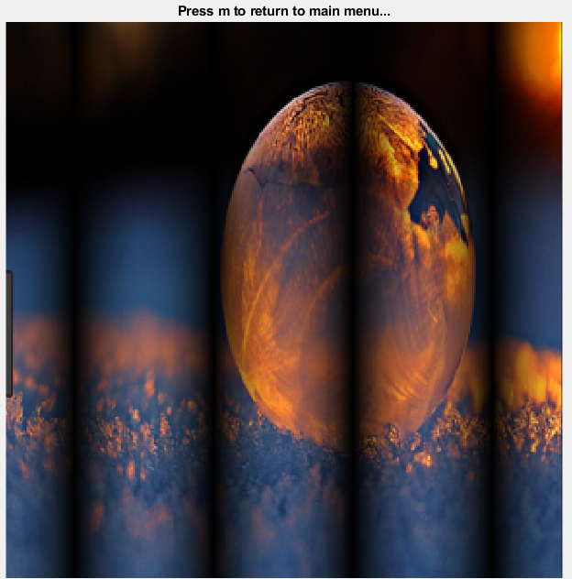
Problem 1.2. Option 2: Image masks
Mode 1
Horizontal
Change the image intensity along the horizontal direction.
There are vertical smooth dark regions.

Slide 28
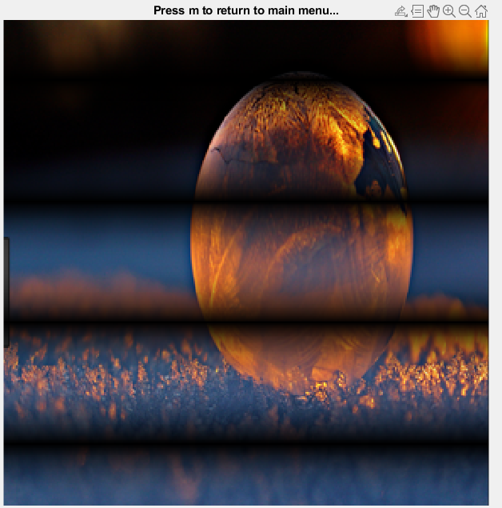
Problem 1.2. Option 2: Image masks
Mode 2
Vertical
Change the image intensity along the vertical direction.
There are horizontal smooth dark regions.

Slide 29
Problem 1.2. Option 2: Image masks
Hint
Use [x y] = meshgrid([1:w]);
Use x and y to produce a horizontal map or a vertical map. Then you need to resize them to fit to the size of the image.
You can type x or y to see their values and you can observe how their values are organized.

Slide 30
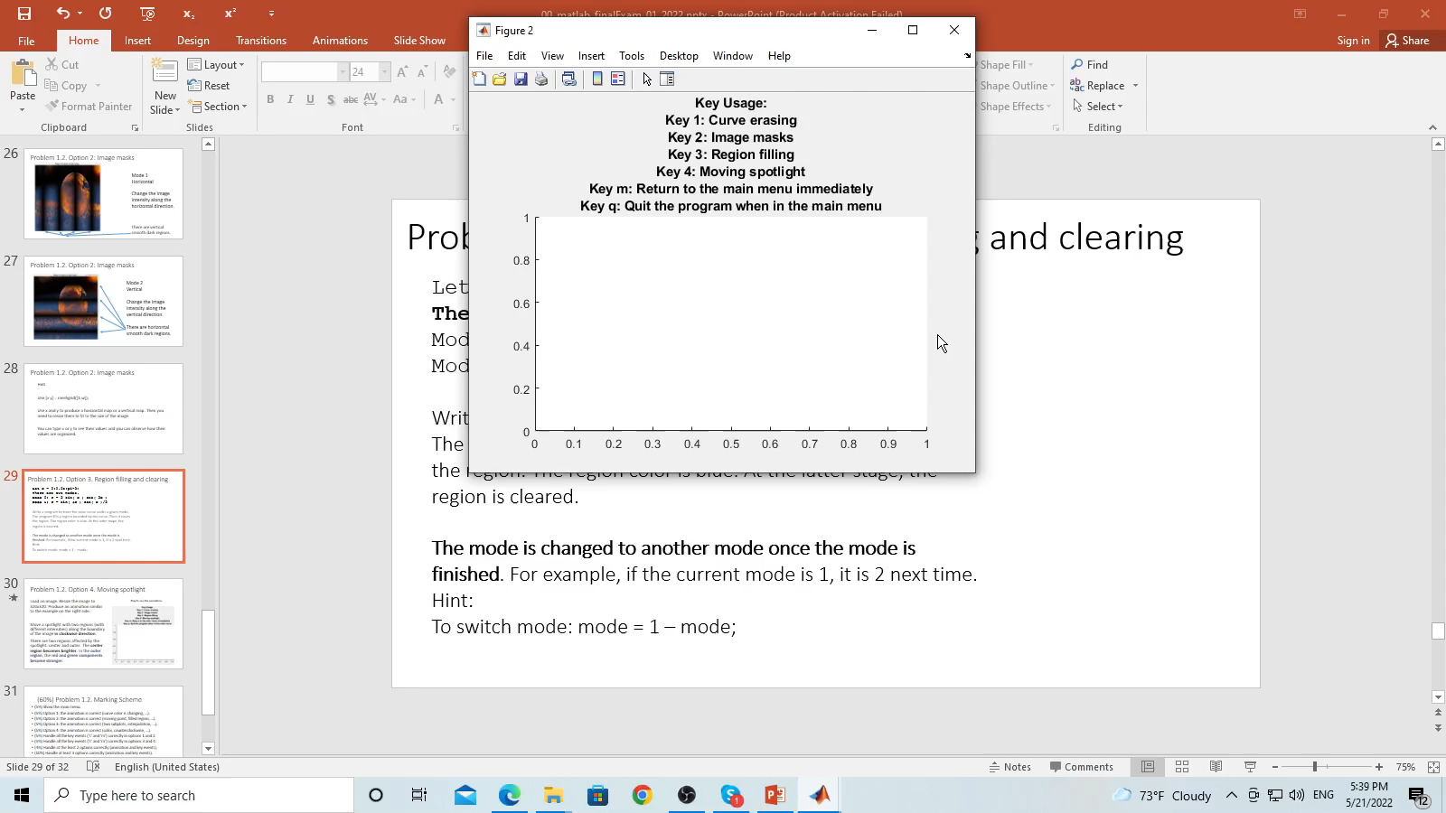
Problem 1.2. Option 3. Region filling and clearing
Let x = 0:0.05:pi*2;
There are two modes.
Mode 0: r = 2 sin( x ) cos( 2x )
Mode 1: r = sin( 4x ) cos( x )/2
Write a program to trace the polar curve under a given mode. The program fills a region bounded by the curve. Then it clears the region. The region color is blue. At the latter stage, the region is cleared.
The mode is changed to another mode once the mode is finished. For example, if the current mode is 1, it is 0 next time.
Hint. To switch mode: mode = 1 – mode;
Play to see the animation

Slide 31
Problem 1.2. Option 4. Moving spotlight
Load an image. Resize the image to 320x320. Produce an animation similar to the example on the right side.
Move a spotlight with two regions (with different intensities) along the boundary of the image in clockwise direction.
There are two regions affected by the spotlight: center and outer. The center region becomes brighter. In the outer region, the red and green components become stronger.
Play to see the animation.

Slide 32
(60%) Problem 1.2. Marking Scheme
(1%) Press ‘q’ to show student ID and name on the console window, close all figure windows, and then quit the program. If you do not implement this item, deduct 20%.
(4%) Show the main menu.
(5+3%) Option 1: the animation is correct (curve is correct; curve color is changing, …).
(5+3%) Option 2: the animation is correct (image masks, horizontal and vertical).
(5+3%) Option 3: the animation is correct (region filling and clearing, …).
(5+3%) Option 4: the animation is correct (color (red+green=yellow), center, clockwise, …).
(4%) Handle all the key events (‘s’ and ‘m’) correctly in options 1 and 2.
(4%) Handle all the key events (‘s’ and ‘m’) correctly in options 3 and 4.
(5%) Handle at the least 2 options correctly (animation and key events).
(5%) Handle at least 3 options correctly (animation and key events).
(5%) Handle all the four options correctly (animation and key events).

Slide 33
End
Enjoy MATLAB Programming.

